Slide 1
Microsoft acquires Nokia
Motives for M&A
Timeline
Nokia’s state before partnership
Salient features of alliance
Reason behind failure

Slide 2
Motives for M&A
Operational Synergy
Strategic Realignment
Tax Consideration
realization of economies of scope, scale, reducing totals costs for a multi-product firm by utilizing specific assets from the partner firm
Acquirers of firms with accumulated losses and tax credits may use them to offset future profits generated by the combined firms
is a process that ensures an organization's structure, use of resources (and culture) support its strategy
Microsoft’s strong capital and better marketing campaign and a known name in operating system
Nokia’s hardware expertise and renowned product line
Necessity of rapidly shifting technological environment
Apple and Google’s OS were snatching away Microsoft’s market share
Microsoft aimed to use the R&D of Nokia for entering the smartphone market
As Nokia was based out of Finland, Microsoft aimed at using a large portion of its foreign cash for its acquisition and dodge heavy tax burden

Slide 3
Timeline
Nokia acquired Symbian
Microsoft launched Surface tablets
Microsoft acquired Nokia’s phone business
December 2, 2008
October 26, 2012
April 25, 2014
February 11, 2011
September 2, 2013
Nokia established alliance with Microsoft
Microsoft announced to acquire Nokia’s mobile device business

Slide 4
Nokia’s state before partnership
Due to competition from Asian rivals for lower-priced phones, the company's market share decreased to 14% at the end of 2013
In 2008, Nokia acquired Symbian for its OS to compete with Apple’s IOS and Google’s Android
Nokia mirrored Google’s strategy to offer smartphone manufactures free softwares
Problem with this strategy:
Inferior quality of Symbian OS as compares to IOS and Android
Nokia's success hinged on their ability to persuade manufacturers to use its software

Slide 5
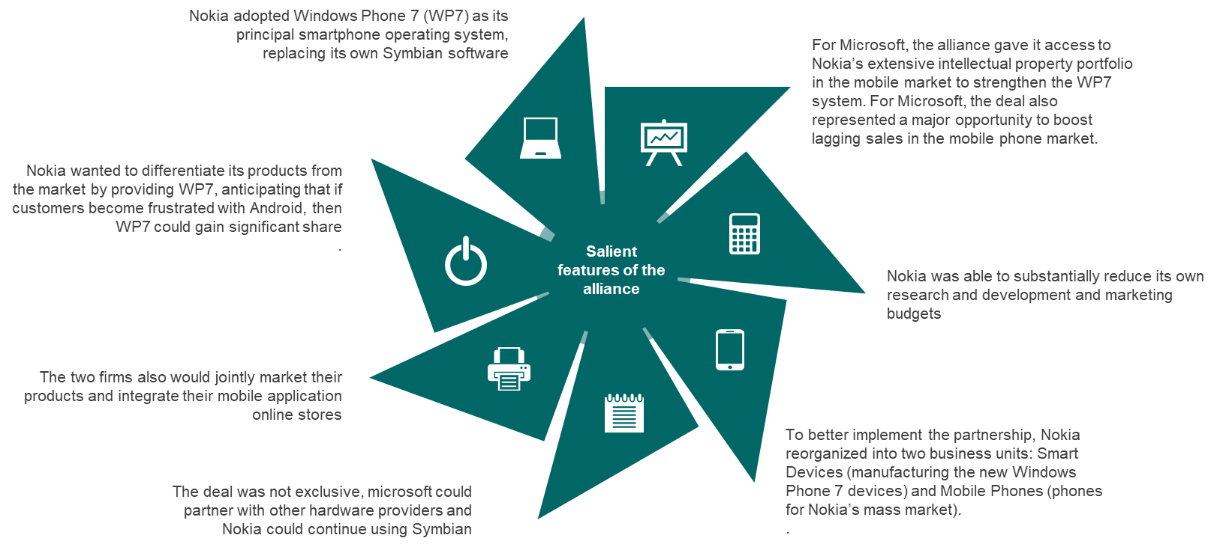

Slide 6
Challenges faced and reasons behind the partnership’s eventual failure
Nokia’s stock fell by 11% while Microsoft’s suffered a dip of 1% at the time of announcement
Investors feared that Microsoft had partnered with a weak player in smartphone market, and by the time they start bulk producing, Apple and Google would have already advanced their stronghold
Microsoft was highly unpopular in Europe where Nokia had its biggest market
Microsoft introduced its own tablet thereby disrupting Nokia’s plans at marketing its own tablet device
Both firms started overlapping with developers, music and app stores making them eventually realize they will be better off operating as a single unit

Slide 7
THANK YOU!
Ayushi Goyal (180182)
Amisha Shahdeo (180078)
Kshitiz Chaurasia (180367)
Shubham Gupta (180749)

